Slide 1
Data Science
Concepts and Foundational Understanding

Slide 2
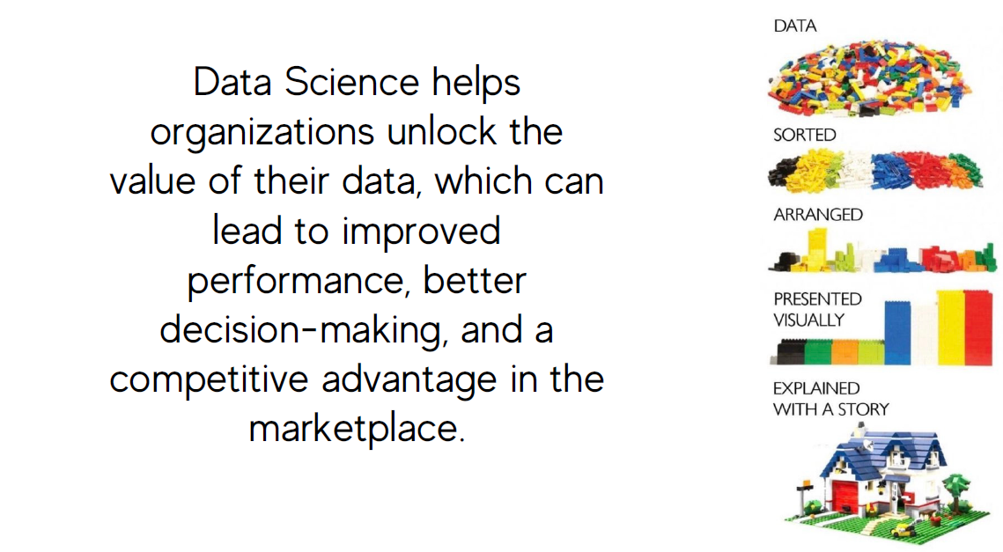

Slide 3
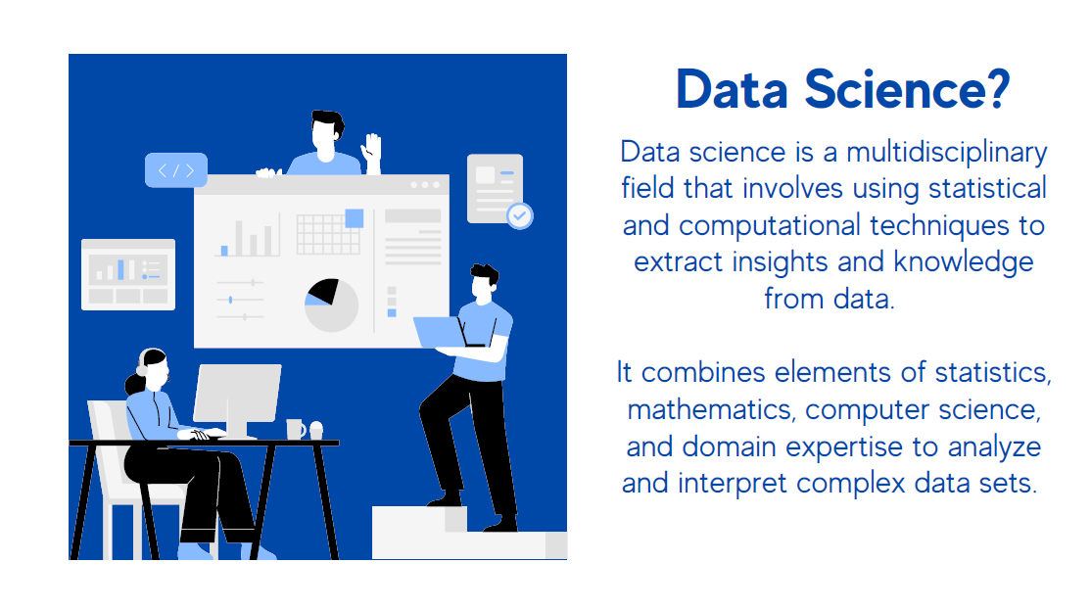

Slide 4
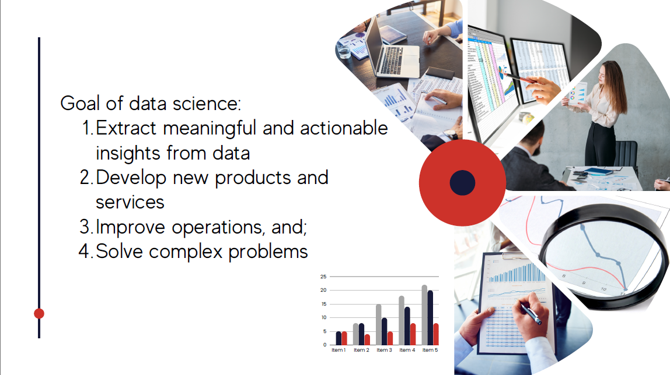

Slide 5


Slide 6
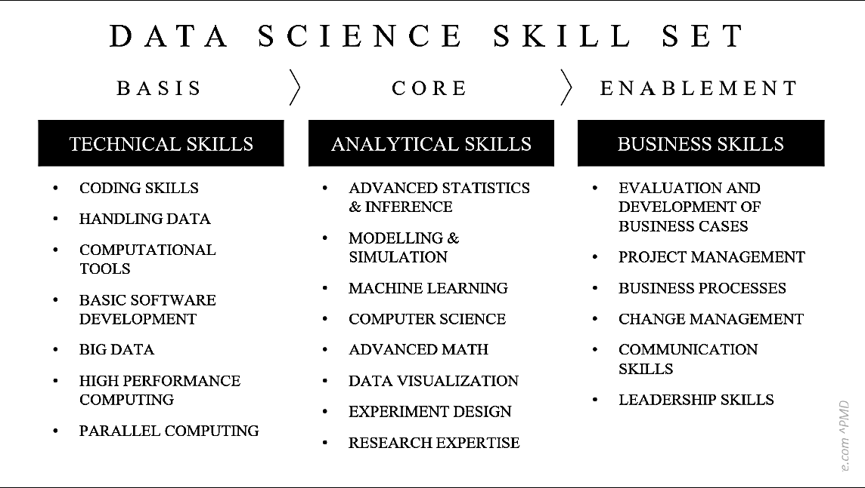

Slide 7
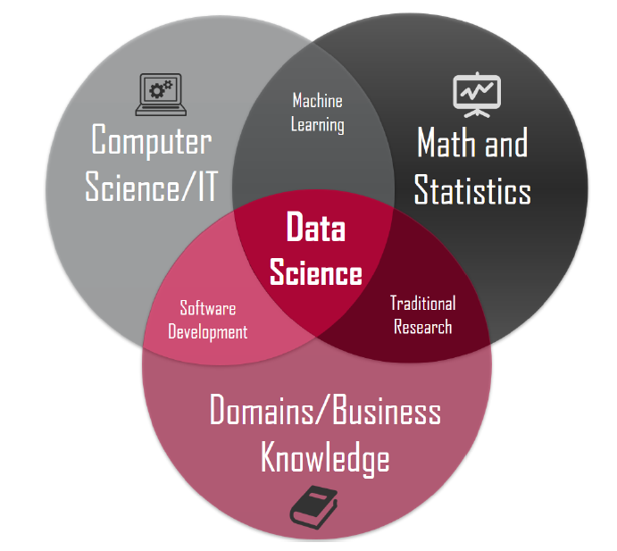

Slide 8
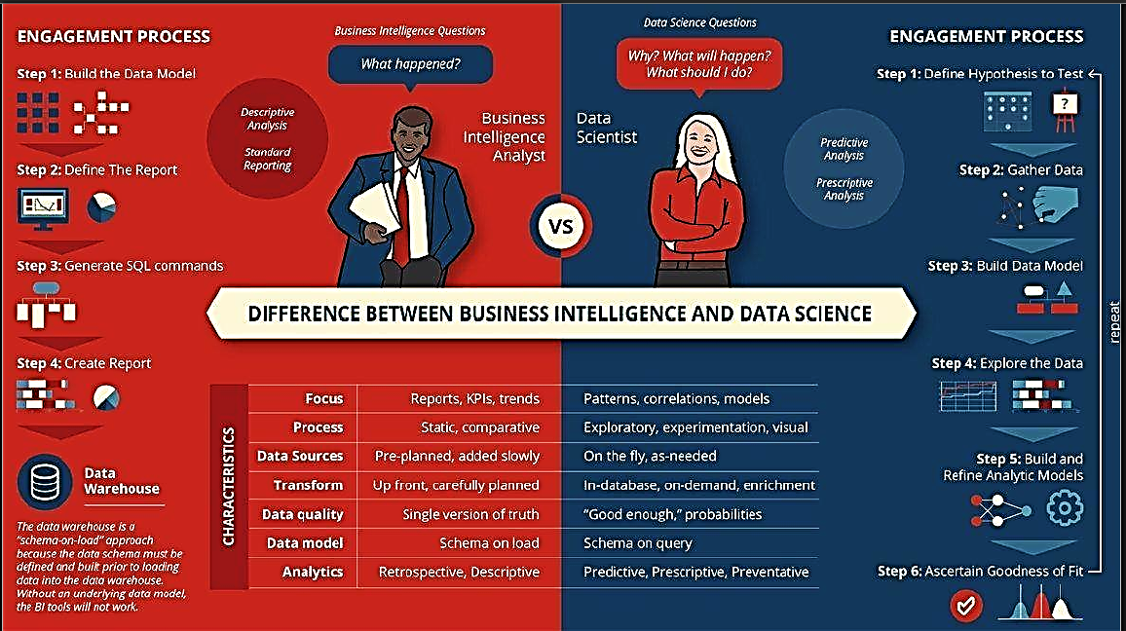

Slide 9
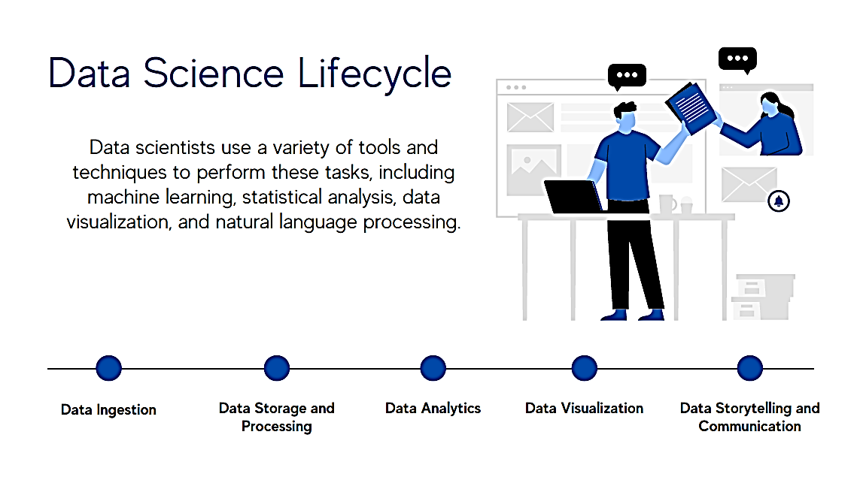

Slide 10
Data Science Lifecycle
The data science lifecycle involves various roles, tools, and processes, which enables analysts to present and perform actionable insights.
Typically, a data science project undergoes the following stages----

Slide 11
Data ingestion
The lifecycle begins with the data collection--both raw structured and unstructured data from all relevant sources using a variety of methods.
These methods can include manual entry, web scraping, and real-time streaming data from systems and devices.
Data sources can include structured data, such as customer data, along with unstructured data like log files, video, audio, pictures, the Internet of Things (IoT), social media, and more.

Slide 12
Data storage and data processing
Data have different formats and structures
Companies need to consider different storage systems based on the type of data that needs to be captured.
Data management teams help to set standards around data storage and structure, which facilitate workflows around analytics, machine learning and deep learning models.
This stage includes cleaning data, deduplicating, transforming and combining the data using ETL (extract, transform, load) jobs or other data integration technologies. This data preparation is essential for promoting data quality before loading into a data warehouse, data lake, or other repository.

Slide 13
Data analysis
Data scientists conduct an exploratory data analysis to examine biases, patterns, ranges, and distributions of values within the data.
This data analytics exploration drives hypothesis generation for a/b testing. It also allows analysts to determine the data’s relevance for use within modeling efforts for predictive analytics, machine learning, and/or deep learning.
Depending on a model’s accuracy, organizations can become reliant on these insights for business decision making, allowing them to drive more scalability.

Slide 14
Communicate
Finally, insights are presented as reports and other data visualizations that make the insights—and their impact on business—easier for business analysts and other decision-makers to understand.
A data science programming language such as R or Python includes components for generating visualizations
Alternately, data scientists can use dedicated visualization tools.

Slide 15
Different Sectors Using Data Science
Almost all industries can benefit from data science and analytics.

Slide 16

Retailers
Retailers need to correctly anticipate what their customers want and then provide those things. If they don’t do this, they will likely be left behind the competition. Big data and analytics provide retailers the insights they need to keep their customers happy and returning to their stores.

Slide 17

Medical Industry
The medical industry is using big data and analytics in a big way to improve health in a variety of ways. For instance, the use of wearable trackers to provide important information to physicians who can make use of the data to provide better care to their patients. Wearable trackers also provide information like whether the patient is taking his/her medication and following the right treatment plan.

Slide 18

Bank
The banking industry is generally not looked at as being one that uses technology a lot. However, this is slowly changing as bankers are beginning to increasingly use technology to drive their decision-making. For instance, the Bank of America uses natural language processing and predictive analytics to create a virtual assistant called Erica to help customers view information on upcoming bills or view transaction histories. The assistant will eventually study their customers’ banking habits and suggest relevant financial advice at appropriate times.

Slide 19

Construction
Construction companies track everything from the average time needed to complete tasks to materials-based expenses and everything in between. Big data is now being used in a big way in the construction industry to drive better decision-making.

Slide 20

Travel
There is always a need for people to reach their destinations on time and data science and analytics can be used by transportation providers, both public and private, to increase the chances of successful journeys. For instance, most Travel Road Guide Apps and uses statistical data to map customer journeys, manage unexpected circumstances, and provide people with personalized transport details.

Slide 21

Social Media and Online Content
Consumers now expect rich media in different formats as and when they want it on a variety of devices. Collecting, analyzing, and utilizing these consumer insights is now a challenge that data science is stepping in to tackle. Data science is being used to leverage social media and mobile content and understand real-time, media content usage patterns. With data science techniques, companies can better create content for different target audiences, measure content performance, and recommend on-demand content.

Slide 22

Education
One challenge in the education industry where data science and analytics can help is to incorporate data from different vendors and sources and use them on platforms not designed for varying data. Schools have developed a learning and management system that can track when a student logs into the system, the overall progress of the student, and how much time is spent on different pages, among other things. Big data can also be used to measure teachers’ effectiveness by fine-tuning teachers’ performance by measuring against subject matter, student numbers, student aspirations, student demographics, and many other variables.

Slide 23

Manufacturing
The manufacturing industry also generates huge amounts of data that has so far gone untapped. The increasing demand and supply of natural resources, such as oil, minerals, gas, metals, agricultural products, etc. has led to the generation of huge amounts of data that is complex, difficult to handle, and a prime candidate for big data analytics.

Slide 24

Government
In the Government, big data has many applications in the public services field. Places where big data is/can be used include in financial market analysis, health-related research, environmental protection, energy exploration, and fraud detection. One specific example is the use of big data analytics by the Social Security System (SSS) to analyze large numbers of social disability claims that come in as unstructured data. Analytics is being used to rapidly process medical information and detect fraudulent or suspicious claims. Another example is the use of data science techniques by the Food and Drug Administration (FDA) to identify and analyze patterns related to food-related diseases and illnesses.

Slide 25

Energy and Utilities
The energy and utilities industry generates and will continue to generate huge amounts of data that can be analyzed using big data analytics. This data can be used to better study the consumption of utilities, which in turn allows for better control of utility use and improved customer feedback. The use of big data by utility companies also allows for improved asset and workforce management and is useful for identifying and correcting errors as soon as possible.

Slide 26
Data Warehousing

Slide 27
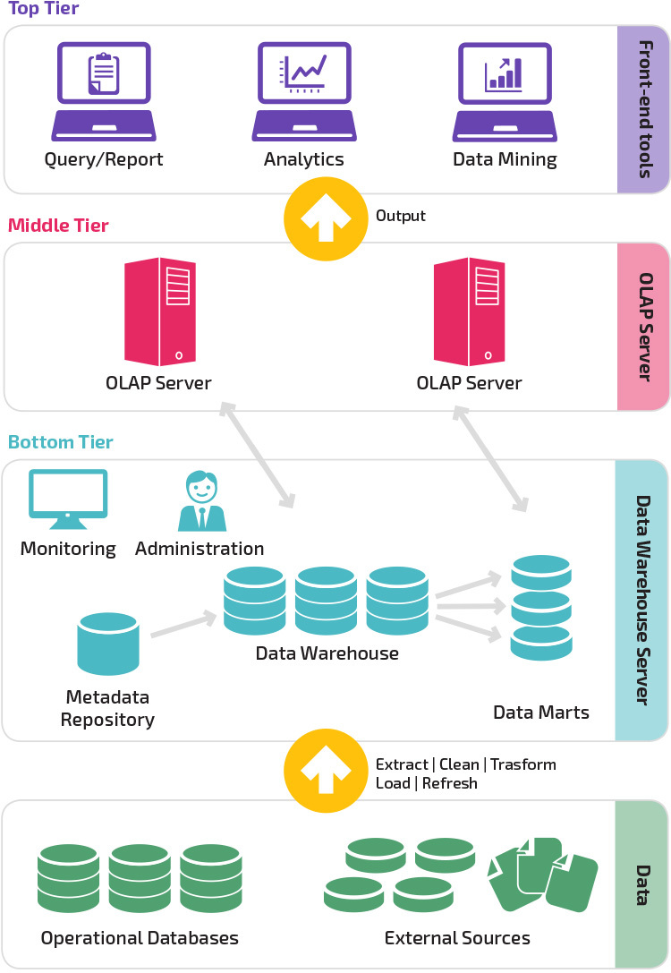
A data warehouse is a relational database that aggregates structured data from across an entire organization. It pulls together data from multiple sources—much of it is typically online transaction processing (OLTP) data. The data warehouse selects, organizes and aggregates data for efficient comparison and analysis.

Slide 28
A data warehouse maintains strict accuracy and integrity using a process called Extract, Transform, Load (ETL), which loads data in batches, porting it into the data warehouse’s desired structure.
Data warehouses provide a long-range view of data over time, focusing on data aggregation over transaction volume. The components of a data warehouse include online analytical processing (OLAP) engines to enable multi-dimensional queries against historical data.
Data warehouses applications integrate with BI tools like Power BI, Tableau, Sisense, Chartio or Looker. They enable analysts using BI tools to explore the data in the data warehouse, design hypotheses, and answer them. Analysts can also leverage BI tools, and the data in the data warehouse, to create dashboards and periodic reports and keep track of key metrics.

Slide 29
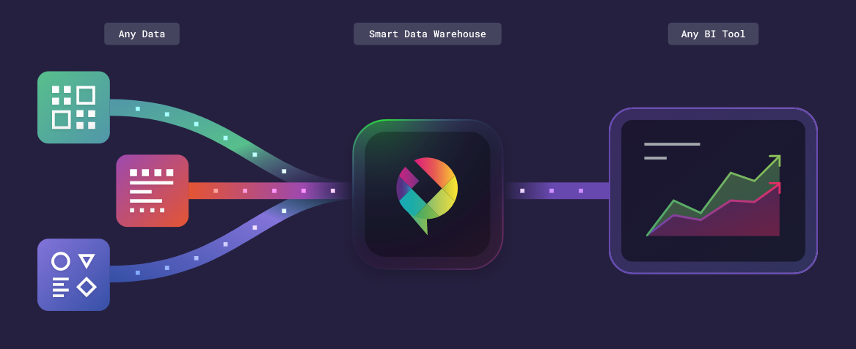
With the advent of data lakes and technologies like Hadoop, many organizations are moving from a strict ETL process, in which data is prepared and loaded to a data warehouse, to a looser and more flexible process called Extract, Load, Transform (ELT).

Slide 30
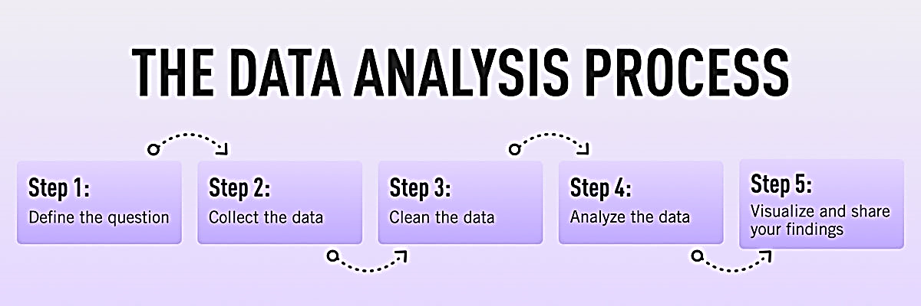
Data Analytics

Slide 31
These core steps can be amended, re-ordered and re-used as you deem fit, but they underpin every data analyst’s work:
Define the question—What business problem are you trying to solve? Frame it as a question to help you focus on finding a clear answer.
Collect data—Create a strategy for collecting data. Which data sources are most likely to help you solve your business problem?
Clean the data—Explore, scrub, tidy, de-dupe, and structure your data as needed.
Analyze the data—Carry out various analyses to obtain insights. Focus on the four types of data analysis: descriptive, diagnostic, predictive, and prescriptive.
Share your results—How best can you share your insights and recommendations? A combination of visualization tools and communication is key.

Slide 32
Exploratory Data Analysis (EDA)
EDA is often used to:
Discover patterns
Spot anomalies
Test hypothesis
Summary statistics
Graphical representations

Slide 33
EDA-Quantitative Technique
Many of the quantitative techniques fall into two broad categories: Interval estimation and Hypothesis tests

Slide 34
Interval Estimates
It is common in statistics to estimate a parameter from a sample of data. The value of the parameter using all of the possible data, not just the sample data, is called the population parameter or true value of the parameter. An estimate of the true parameter value is made using the sample data. This is called a point estimate or a sample estimate.
For example, the most commonly used measure of location is the mean. The population, or true mean is the sum of all the members of the given population divided by the number of members in the population. As it is typically impractical to measure every member of the population, a random sample is drawn from the population. The sample mean is calculated by summing the values in the sample and dividing by the number of values in the sample. This sample mean is then used as the point estimate of the population mean.

Slide 35
Hypothesis Tests
Hypothesis tests also address the uncertainty of the sample estimate. However, instead of providing an interval, a hypothesis test attempts to refute a specific claim about a population parameter based on the sample data
. For example, the hypothesis might be one of the following:
the population mean is equal to 10
the population standard deviation is equal to 5
the means from two populations are equal
the standard deviations from 5 populations are equal
To reject a hypothesis is to conclude that it is false. However, to accept a hypothesis does not mean that it is true, only that we do not have evidence to believe otherwise. Thus hypothesis tests are usually stated in terms of both a condition that is doubted (null hypothesis) and a condition that is believed (alternative hypothesis).

Slide 36
Sampling

Slide 37
Sampling in Excel
Random Sampling using RAND()
(Data is in range A2:F101 (100 rows))
a. In a new column (e.g., Column G), enter: =RAND()
*This generates a random number between 0 and 1.
b. Copy the formula down for all rows.
c. Select the entire dataset including the RAND column.
d. Go to Data tab → Click Sort → Sort by the RAND column (smallest to largest or vice versa).
e. Pick the top n rows (e.g., first 10 rows for a 10% sample).

Slide 38
Sampling in Excel
2. Using Data Analysis Toolpak (Simple Random Sampling)
If enabled:
a. Go to Data > Data Analysis > Sampling.
b. Choose Input Range (include column headers if checked).
c. Choose Random sampling.
d. Enter the sample size.
e. Choose Output Range or new worksheet.
f. Click OK.

Slide 39
Sampling in Power BI
1. Random Sampling with Power Query
a. Load your dataset into Power BI.
b. Click Transform Data → opens Power Query Editor.
c. Add a new column:
d. Go to Add Column > Custom Column, and enter:
Number.RandomBetween(1, 100)
or
Number.Random()
e. Sort the column (ascending/descending).
f. Use Keep Rows > Keep Top Rows (e.g., 10 or 20 rows).

Slide 40
Sampling in Power BI
2. Using DAX for Random Sampling (Report View)
(Example, table is named Sales)
Add a calculated column:
RandomValue = RAND()
Create a new table with top N samples:
SampledSales = TOPN(10, Sales, Sales[RandomValue])
*You can now use SampledSales as a new table in visuals.

Slide 41
Sampling in Power BI
3. Sampling in Power BI via Filters
If you don’t need a perfectly random sample:
Use slicers or filters to take a subset:
Filter by Region, Product, Date Range, etc.
Manually select a few values

Slide 42
Steps to Perform EDA
Excel

Slide 43
EDA in Excel
1. Load and Clean Your Data
Use Power Query to load your dataset (from CSV, Excel file, SQL, etc.)
Use Power Query for:
  Removing duplicates
  Handling missing values
  Changing data types
  Filtering rows
  Creating calculated columns

Slide 44
EDA in Excel
2. Descriptive Statistics
Use Excel functions
or Data Analysis Toolpak
(enable via File > Options > Add-ins):
Mean, Median, Mode → =AVERAGE(), =MEDIAN(), =MODE.SNGL()
Standard Deviation, Variance → =STDEV.S(), =VAR.S()
Min/Max → =MIN(), =MAX()
Count, Unique Count → =COUNT(), =COUNTA(), =UNIQUE()

Slide 45
EDA in Excel
3. Visualizations
Use charts to explore patterns:
  Histograms
  Box Plots
  Scatter Plots
  Pivot Charts
  Bar/Column Charts

Slide 46
EDA in Excel
4. Pivot Tables
Use PivotTables to:
  Aggregate data
  Analyze categorical features
  Drill into distributions and groupings

Slide 47
Steps to Perform EDA
Power BI

Slide 48
EDA in Power BI
1. Load and Transform Data
Use Power Query Editor to:
  Clean nulls
  Change data types
  Rename columns
  Create new columns
  Split/merge columns

Slide 49
EDA in Power BI
2. Data Profiling
In Power Query Editor:
Enable Column Quality, Column Distribution, and Column Profile
under View tab
These show:
Count of distinct/empty values
Value distribution
Min, max, mean, standard deviation

Slide 50
EDA in Power BI
3. Create Summary Statistics
Use DAX measures or visuals for:
Mean, Median, Mode
Variance, Standard Deviation
Min, Max
Counts and % distributions
Example DAX:
DAXCopyEditAverage Sales = AVERAGE('Sales'[Amount])

Slide 51
EDA in Power BI
4. Visualizations
Use these for EDA:
  Bar/Column Charts → category distribution
  Histograms → numeric data distribution (custom binning)
  Box Plots → use custom visuals
  Scatter Plots → correlation analysis
  Matrix/Table Visuals → Pivot-style analysis

Slide 52
EDA in Power BI
5. Filters and Slicers
Use slicers and filters to segment data and observe trends or anomalies in subsets.

Slide 53
Data Profiling
Data profiling is the process of examining the data available by performing
descriptive analysis
informative summaries about the data
Data profiling help us make a thorough assessment of data quality and helps us understand the
Content
Structure
Relationship

Slide 54
Data Mining
Data mining is the process of:
Discovering patterns
Extracting useful insights
Predicting future trends
Using statistical and computational methods

Slide 55
What You Can Do in Excel (Without Add-ins)
Descriptive Statistics → Explore basic data properties
Correlation & Regression → Identify relationships
Clustering / Segmentation → Use PivotTables and filters
Classification / Forecasting → Limited, but some predictive modeling possible
Association → Identify common co-occurrence patterns

Slide 56
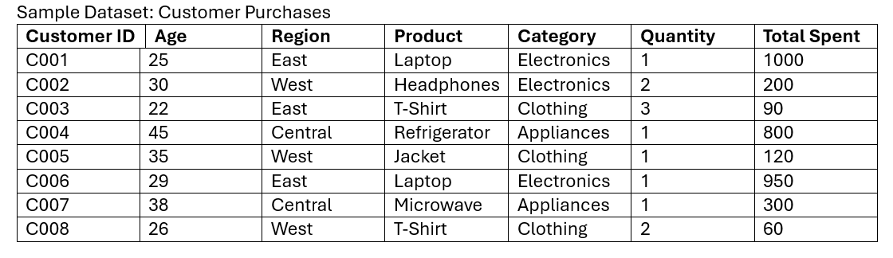

Slide 57
Data Mining Workflow in Excel
Load and Prepare Data
Paste or import the dataset into Excel.
  Format it as a Table: Insert > Table
  Clean the data:
    Remove duplicates
    Fill or delete missing values
    Convert data types (Age = Number, Total Spent = Currency)

Slide 58
Data Mining Workflow in Excel
1. Load and Prepare Data
Paste or import the dataset into Excel.
Format it as a Table: Insert > Table
Clean the data:
Remove duplicates
Fill or delete missing values
Convert data types (Age = Number, Total Spent = Currency)

Slide 59
Data Mining Workflow in Excel
2. Descriptive Analysis (Profiling)
Use formulas:
Average Age =AVERAGE(B2:B9)
Total Revenue =SUM(G2:G9)
Average Spend per Customer =AVERAGE(G2:G9)
Most common product =MODE(C2:C9) (if numeric) or use PivotTable

Slide 60
Data Mining Workflow in Excel
3. Segment Data (Clustering-like)
Insert PivotTable
Rows → Region
Values → Sum of Total Spent, Average Age
This helps identify:
Top performing regions
Age trends by region
*You’ve now clustered by region.

Slide 61
Data Mining Workflow in Excel
4. Association Mining (Basket Analysis)
Count co-occurrence:
Use COUNTIFS() or PivotTables to find how often products are purchased together.
Example:
How many people aged 25–30 bought Electronics?
=COUNTIFS(B2:B9,">=25",B2:B9,"<=30",E2:E9,"Electronics")

Slide 62
Data Mining Workflow in Excel
5. Predictive Modeling (Regression)
Go to Data > Data Analysis > Regression (Enable Analysis Toolpak if not visible)
Input:
Y Range (Dependent Variable): Total Spent
X Range (Independent Variables): Age or Quantity
Click OK
*This shows if Age or Quantity can predict Total Spent.

Slide 63
Data Mining Workflow in Excel
6. Correlation Matrix
Go to Data > Data Analysis > Correlation
Select numerical columns: Age, Quantity, Total Spent
Result: How strongly each variable relates to another

Slide 64
Data Analytics Communication
1. Start with an Outline
2. Make a Selection of Vital KPIs
3. Pick the Right Charts for Appealing Design
4. Use a Narrative
5. Organize the Information
6. Include a Summary
7. Careful with Your Recommendations
8. Double-Check Everything
9. Use Interactive Dashboards

Slide 65
Data Types for Plotting
Qualitative and Quantitative Data

Slide 66
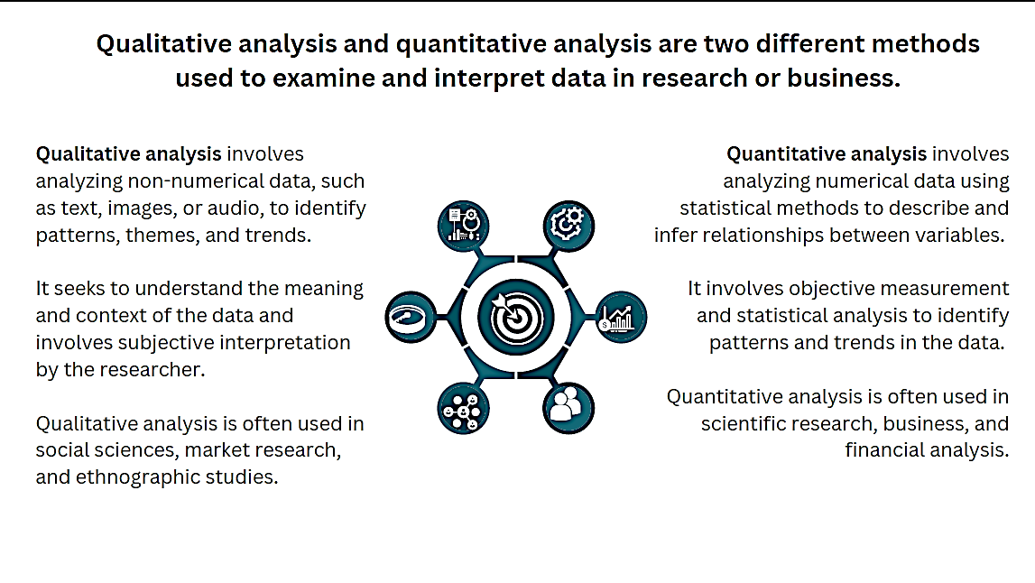

Slide 67
Quantitative
The information is recorded as numbers and represents an objective measurement or a count. Temperature, weight, and a count of transactions are all quantitative data. Analysts also refer to this type as numerical data.
Qualitative
The information represents characteristics that you do not measure with numbers. Instead, the observations fall within a countable number of groups. In fact, this type of variable can capture information that isn’t easily measured and can be subjective. Taste, eye color, architectural style, and marital status are all types of qualitative variables.

Slide 68
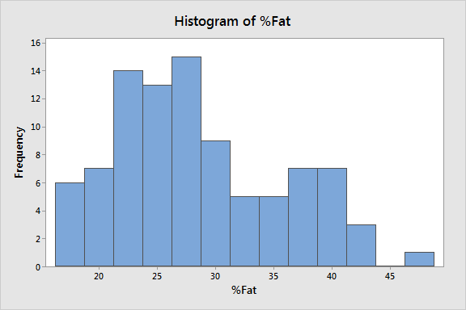
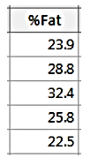
Types of Quantitative Data:
Continuous and Discrete
Continuous data
Continuous variables can take on any numeric value, and it can be meaningfully divided into smaller increments, including fractional and decimal values. There are an infinite number of possible values between any two values. Typically, you measure continuous variables on a scale. For example, when you measure height, weight, and temperature, you have continuous data.
With continuous variables, you can assess measures of central tendency and variability, such as the mean, median, distribution, range, and standard deviation. For example, the mean height in the U.S. is 5 feet 9 inches for men and 5 feet 4 inches for women.

Slide 69
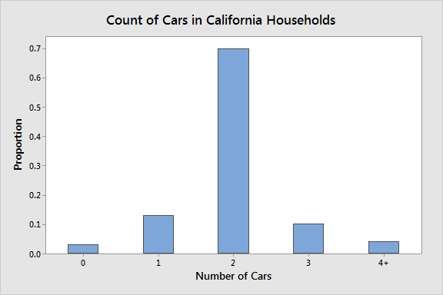
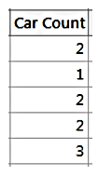
Types of Quantitative Data:
Continuous and Discrete
Discrete data
Discrete quantitative data are a count of the presence of a characteristic, result, item, or activity. These measures cannot be meaningfully divided into smaller increments. For example, a single household can have 1 or 2 cars, but it cannot have 1.6. There are a finite number of possible values that you can record for an observation.
With discrete variables, you can calculate and assess a rate of occurrence or a summary of the count, such as the mean, sum, and standard deviation. For example, U.S. households had an average of 2.11 vehicles in 2014.

Slide 70
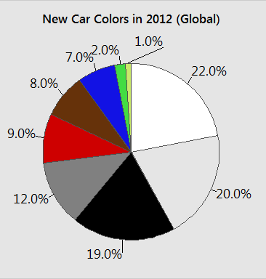
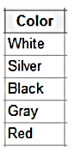
Types of Qualitative Data:
Categorical, Binary, and Ordinal
Categorical data
Categorical data have values that you can put into a countable number of distinct groups based on a characteristic. For a categorical variable, you can assign categories, but the categories have no natural order. Analysts also refer to categorical data as both attribute and nominal variables
For example, college major is a categorical variable that can have values such as psychology, political science, engineering, biology, etc.

Slide 71
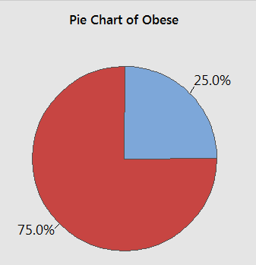
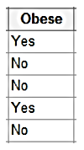
Types of Qualitative Data:
Categorical, Binary, and Ordinal
Binary data
Binary data can have only two values. If you can place an observation into only two categories, you have a binary variable. Statisticians also refer to binary data as both dichotomous and indicator variables. For example, pass/fail, male/female, and the presence/absence of a characteristic are all binary data.
Binary variables are helpful for calculating proportions or percentages, such as the proportion of defective products in a sample. You just take the number of faulty products and divide by the sample size.

Slide 72
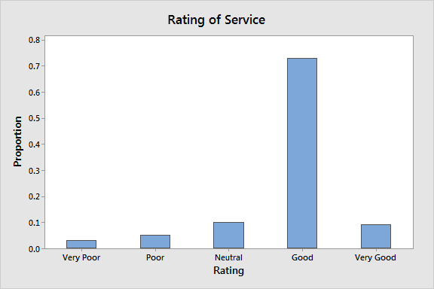
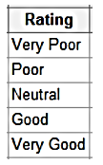
Types of Qualitative Data:
Categorical, Binary, and Ordinal
Ordinal data
Ordinal data have at least three categories, and the categories have a natural order. Examples of ordinal variables include overall status (poor to excellent), agreement (strongly disagree to strongly agree), and rank (such as sporting teams).
For example, first, second, and third in a race are ordinal data. The difference in time between first and second place might not be the same the difference between second and third place.

Slide 73
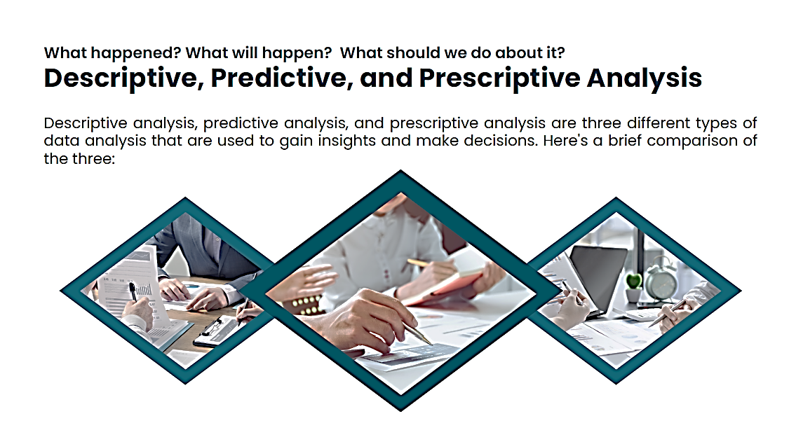

Slide 74
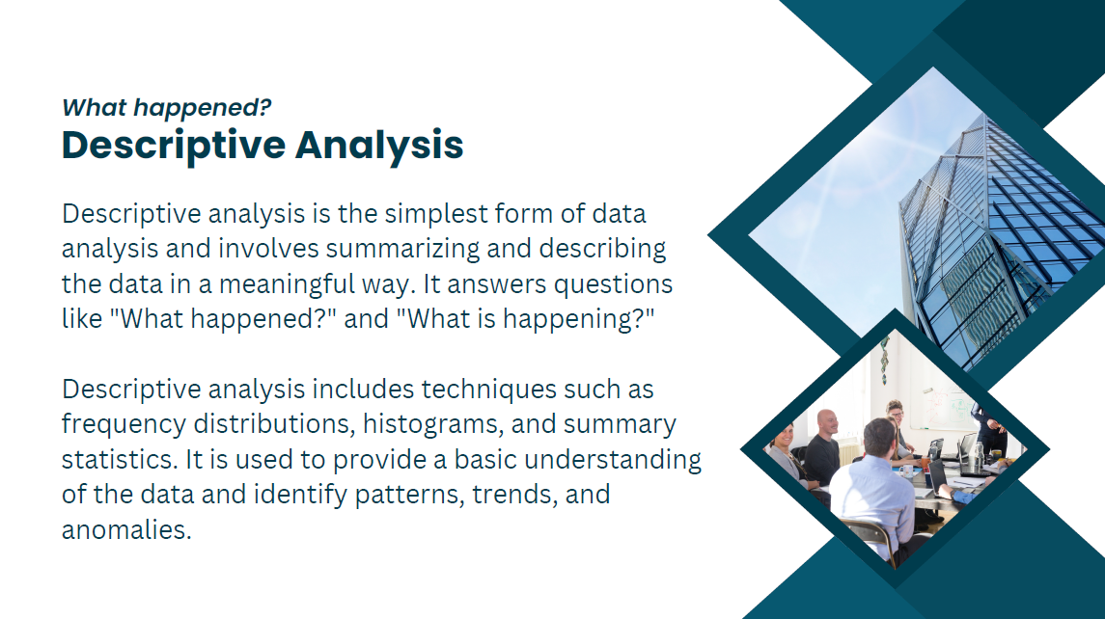

Slide 75
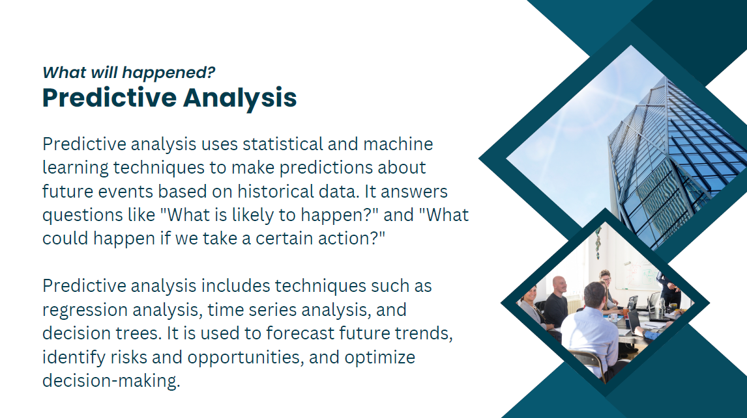

Slide 76
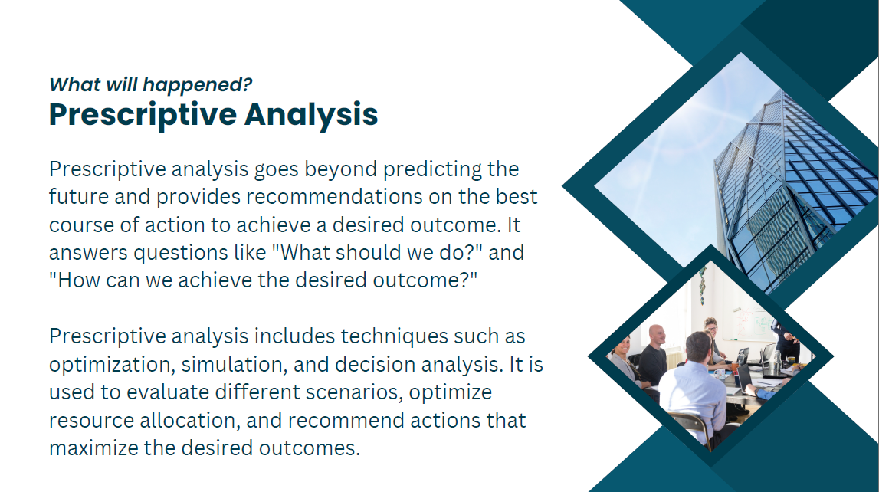

Slide 77
Data Analytics vs Data Mining vs Data Profiling vs EDA

Slide 78
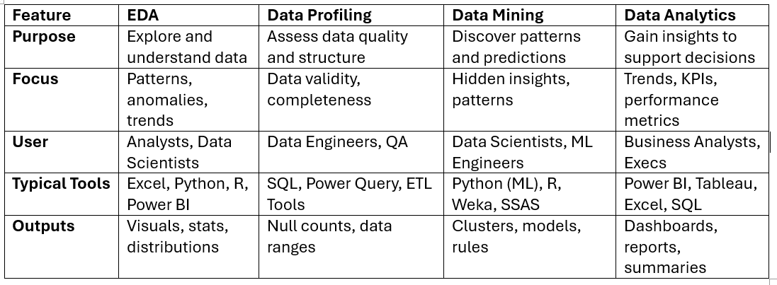

Slide 79
Handling “Big Data”

Slide 80
Big Data in Excel
Excel is not designed for big data, but you can optimize it:
Excel Limitations:
• Max rows per sheet: 1,048,576
• Slows down with large file sizes (>100MB)
• Limited memory management (relies on RAM)

Slide 81
Strategies to Handle Big Data in Excel:
1. Use Power Query (Get & Transform)
• Load only needed columns and rows
• Apply filters early to reduce data volume
• Use Power Query’s “Enable Fast Load” feature
2. Use Excel Data Model (Power Pivot)
• Load data into the Data Model, not the worksheet
• Create relationships and measures using DAX
• Excel compresses data more efficiently in the Data Model

Slide 82
Strategies to Handle Big Data in Excel:
3. Avoid Volatile Formulas
• Use =SUMIFS() instead of =ARRAYFORMULA() or volatile functions like OFFSET() or INDIRECT()
4. Use External Connections
• Connect Excel to SQL Server, Azure, or Power BI datasets to query only needed data
• Use Data > Get Data > From Database or Web/ODBC
5. Split or Archive Data
• Keep raw data in CSV/Text files and use queries to retrieve parts
• Archive older records

Slide 83
Handling Big Data in Power BI
1. Use Power BI Dataflows (in Power BI Service)
• Preprocess and transform data in the cloud
• Reuse across reports and teams
2. DirectQuery or Live Connections
• Don’t import full dataset
• Connect live to large databases like:
Azure Synapse
SQL Server
Snowflake
Databricks

Slide 84
Handling Big Data in Power BI
3. Aggregation Tables
• Build pre-aggregated summary tables in the model
• Faster than querying raw, detailed data
4. Incremental Refresh
• Only load new or changed data instead of reloading full datasets
• Set up in Power BI Pro or Premium: Model > Table > Incremental Refresh
5. Optimize DAX and Model Design
• Avoid complex calculated columns (use Power Query instead)
• Use star schema modeling
• Limit column cardinality (fewer unique values = faster performance)

Slide 85
The need to learn Statistics

Slide 86


Slide 87
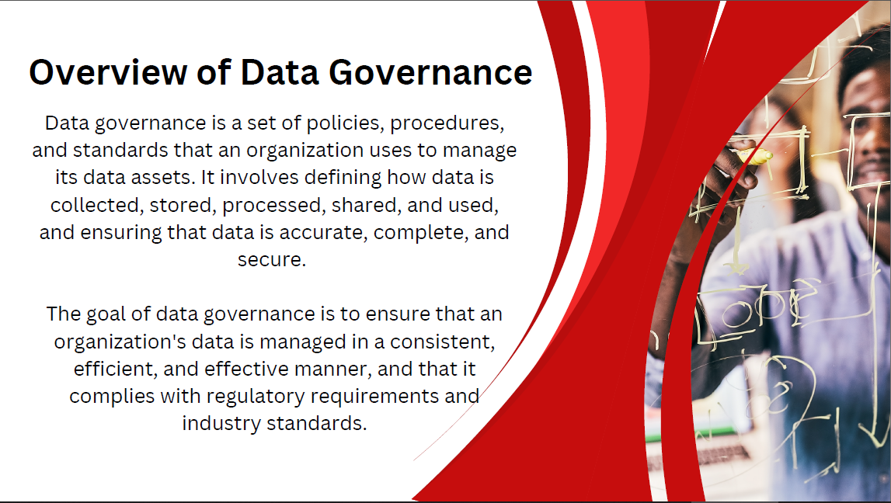

Slide 88
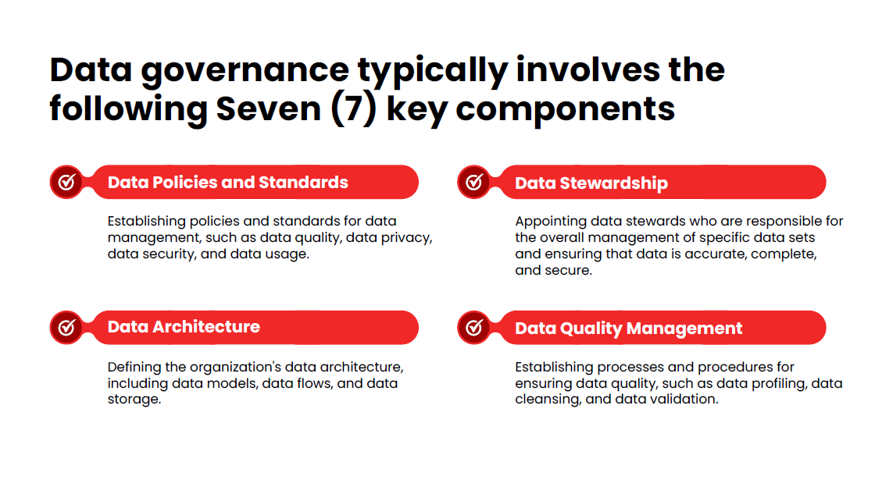

Slide 89
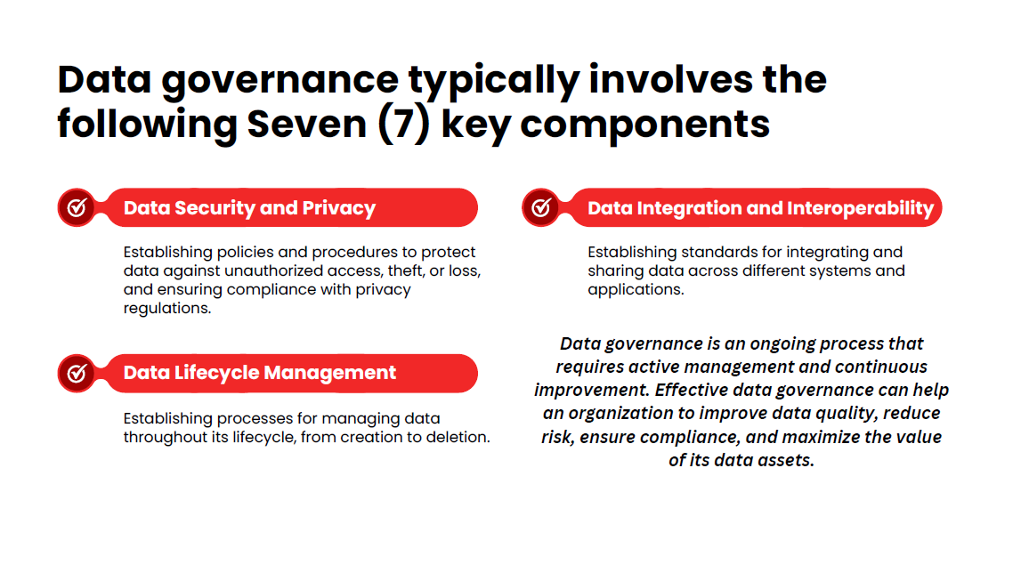

Slide 90


Slide 91


Slide 92


Slide 93


Slide 94


Slide 95


Slide 96


Slide 97


